Slide 1

Introduction to Cloud Computing
Week 9
Azure Artificial Intelligence, Machine Learning & Big Data
CS-4037
Muhammad Sudais
muhammad.sudais.v@nu.edu.pk

Slide 2
CHAPTER 6 Artificial Intelligence, Machine Learning, and Cognitive Services in Azure
|LEARNING MICROSOFT AZURE

Slide 3
Overview of AI in Azure
The future of applications lies in AI and ML for increased efficiency and value creation.
Cognitive Services: Pre-built AI capabilities for apps without needing AI/ML expertise.
Azure Machine Learning: A complete platform for ML engineers and data scientists.
AI Builder: Enables citizen developers to create intelligent apps with no-code tools.

Slide 4
Understanding Artificial Intelligence
AI: Simulates human intelligence to automate decision-making and improve efficiency.
Gartner Definition: AI involves advanced analysis and logic, supporting and automating decisions.
Key languages and tools: Python, C#, R, Azure AI Services.

Slide 5
Addressing AI Misconceptions
Common sci-fi misconceptions: AI will replace jobs entirely.
Reality: AI enhances work by automating repetitive tasks and allowing humans to focus on creative roles.
Future-proofing careers with AI knowledge.

Slide 6
Azure OpenAI Service and GPT Evolution
Launched in 2023, providing access to models like GPT-3.5, GPT-4, Codex, and DALL-E 2.
Enterprise-grade AI models for building large-scale AI solutions.
Integration in tools like GitHub Copilot, Power BI, and Microsoft Designer.
Azure OpenAI service requires an application to use, ensuring responsible AI usage.

Slide 7
Key AI Innovations in Azure
Natural Language Processing (NLP): Used for chatbots, IVR systems, etc.
Internet of Things (IoT): AI applied in smart homes, healthcare, transportation.
Computer Vision (CV): Object recognition in self-driving cars, retail, and drones.
Synthetic Data: Generated to protect sensitive info and train AI models.
Edge AI: Deploy AI at the "edge," enabling real-time responses in devices.

Slide 8
Generative AI in Action
GenAI creates content (images, text, etc.) based on learned data without replication.
Used in fields like media creation, content generation, and virtual agents.
Example: Virtual health assistants (VHAs) in healthcare.

Slide 9
Why AI is Important for Businesses
AI automates repetitive tasks, increasing productivity and allowing for strategic focus.
Enhances decision-making by providing deep insights from data analysis.
Cost savings by optimizing operations, predicting demand, and improving customer service.

Slide 10
Challenges in AI Adoption
Gartner: Many organizations struggle with AI trust and transparency.
Importance of model governance, responsible AI usage, and avoiding harmful outcomes.
Regulations around AI are emerging to ensure ethical deployment.

Slide 11
High Demand for AI Skills
Roles: Machine Learning Engineer, Data Analyst, Business Intelligence Developer, AI Software Engineer.
AI skills are required for modern IT solutions and cloud technologies.
Growing opportunities across industries (e-commerce, healthcare, finance).

Slide 12
Starting with AI in Azure
Azure Cognitive Services: Pre-built APIs for language, vision, speech, and decision-making.
Azure Machine Learning: Build, train, and deploy ML models at scale.
AI Builder: No-code AI development for Power Apps and Power Automate.

Slide 13
The Future of AI in Azure
AI innovations will continue to grow in areas like healthcare, finance, and customer service.
Edge AI and IoT will enable faster, real-time processing.
Azure’s platform provides scalable, secure AI solutions for businesses.

Slide 14
What is Machine Learning?
ML is a subfield of AI focused on creating algorithms and models that learn from and make predictions based on data.
Core Concept: ML enables systems to learn from data patterns to improve prediction accuracy without being explicitly programmed.

Slide 15
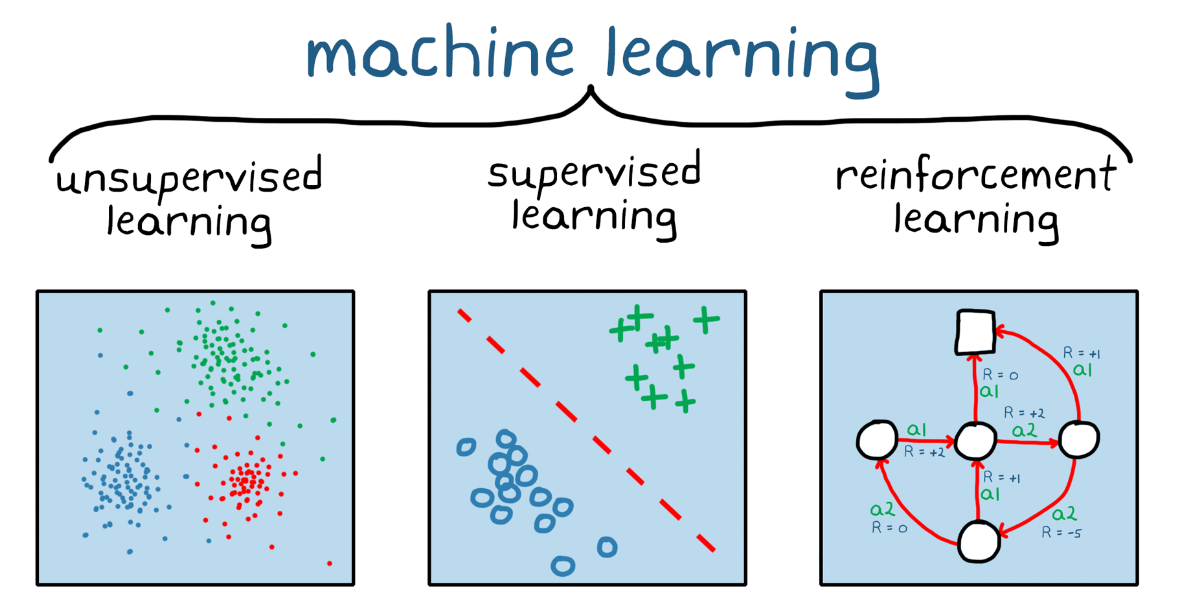
Categories of Machine Learning
Supervised Learning: Trained on labeled data with known outputs. Example: Predicting house prices.
Unsupervised Learning: Trained on unlabeled data to identify hidden patterns. Example: Customer segmentation.
Reinforcement Learning: Trained to make decisions based on rewards or penalties. Example: Game AI or self-driving cars.

Slide 16
What is MLOps?
Similar to DevOps, but for ML. MLOps automates the entire ML lifecycle from development to deployment.
Goal: Ensure scalability, reliability, and effective deployment of ML models.

Slide 17
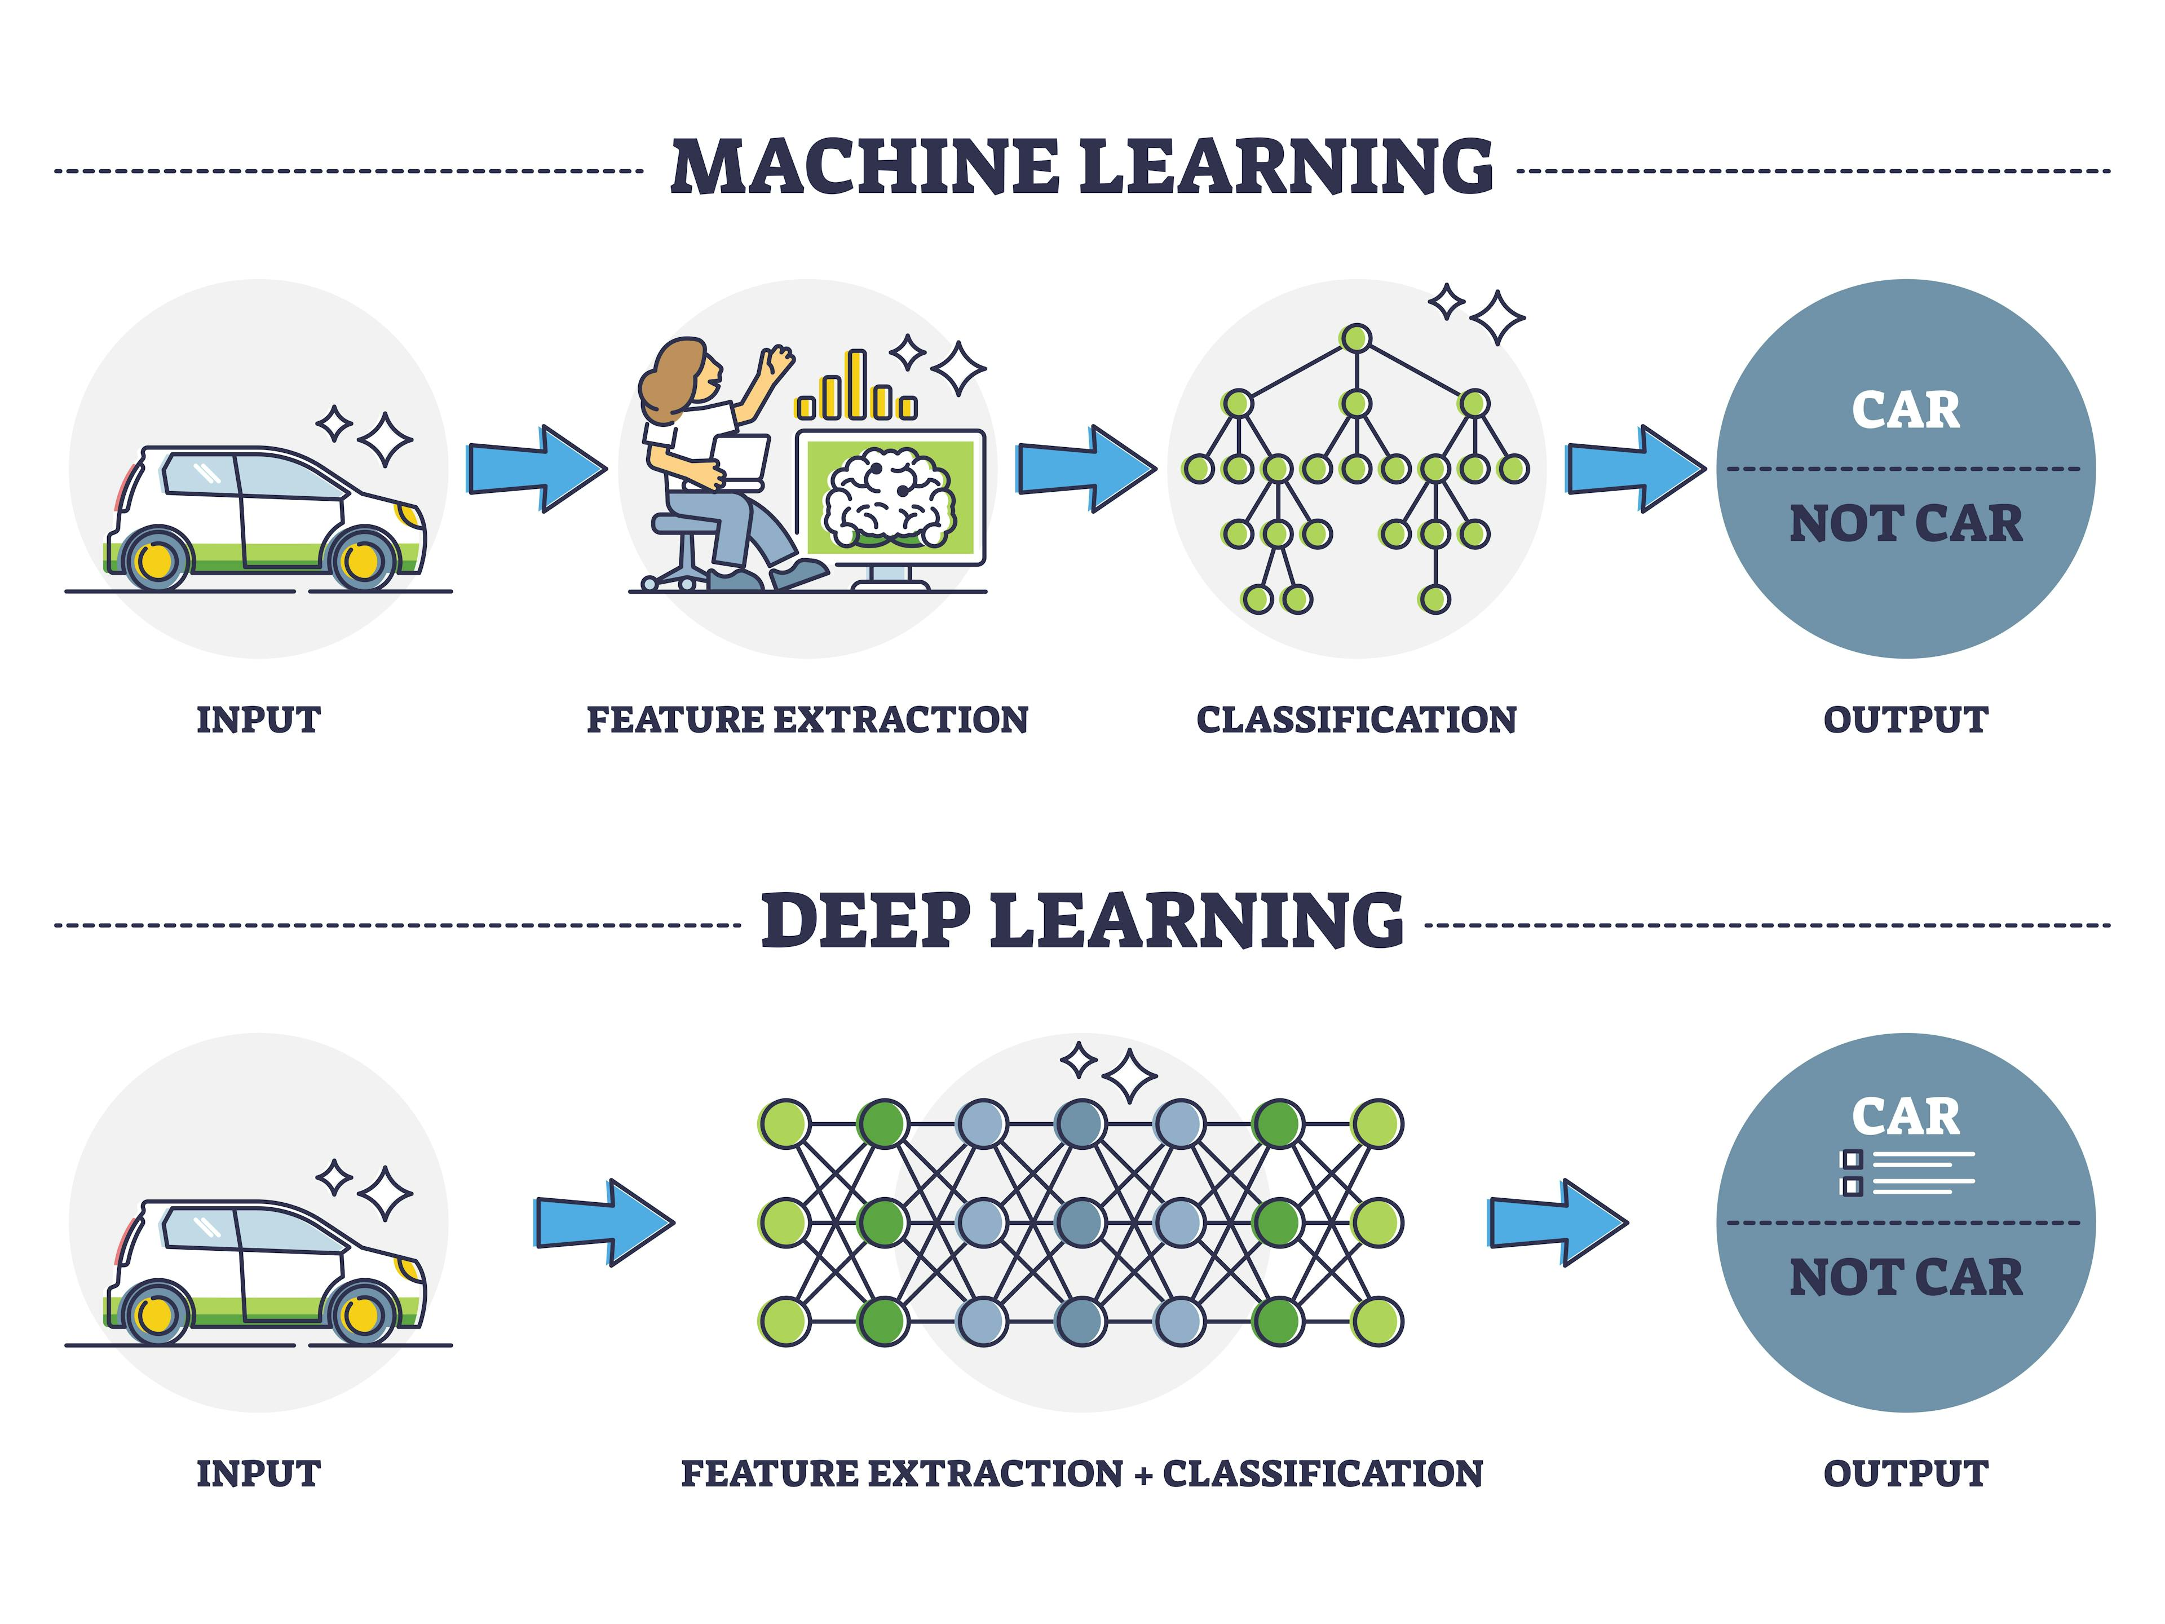
Deep Learning in ML
A subset of ML that uses artificial neural networks with multiple layers.
Key Applications: Autonomous vehicles, speech recognition, image classification, and medical diagnoses.

Slide 18
What is Ethical AI?
Ethical AI focuses on designing AI systems that are fair, transparent, and responsible.
Core Question: What should these systems be allowed to do?
Ethical AI ensures that AI technologies maintain human dignity and don’t harm society.

Slide 19
Responsible AI Practices on Azure
Microsoft developed Fairlearn, a toolkit to detect and mitigate fairness issues in AI models.
Key Focus Areas:
Fairness in data and algorithms.
Transparency and accountability.
Mitigation of biased decisions.

Slide 20
Addressing Ethical Concerns in AI
Real-World Issue: Self-driving car accidents and responsibility.
Ethical AI must comply with laws, norms, and expectations.
Future Outlook: Research indicates concerns over AI being optimized for returns and authority, not public good.

Slide 21
Ethical Considerations in AI
Ensuring trust, transparency, and responsible AI implementation.
Managing risks like biased models, incorrect decisions, and privacy concerns.
Importance of AI governance and regulations to protect users.

Slide 22
Why Ethical AI Matters
Risks of Unethical AI:
Bias in decision-making
Lack of accountability.
Microsoft’s Efforts:
Providing tools for responsible AI development
Ensuring fairness, liability, safety, and security.
"Ethical AI is not just a technological issue, but a societal one."

Slide 23
Introduction to Azure AI and Cognitive Services
Overview:
A suite of powerful APIs that enable developers to add intelligent features into their applications.
Key Features:
Pre-built APIs for vision, speech, language, and decision-making tasks.
No deep AI knowledge required to integrate.
Accessible via REST APIs, SDKs, and services that can run in the cloud or on edge devices.
Use Cases:
Add speech recognition to call centers.
Automate text analysis in document workflows.
Implement intelligent chatbots for customer service.

Slide 24
Key Benefits of Using Azure AI
Customizable pre-trained models: Leverage Microsoft’s AI research for faster development.
Supports hybrid cloud and edge scenarios: Run AI in the cloud or on local devices, providing flexibility and scalability.
Broad API support across industries: Tailored solutions for healthcare, retail, manufacturing, and more.
Security and Compliance: Built-in support for data governance, privacy, and regulatory compliance with Azure's trusted cloud infrastructure.

Slide 25
Cognitive Services Overview
Speech: Convert speech to text, translate languages, text-to-speech.
Vision: Analyze visual data and images, recognize objects, faces, and handwriting.
Language: NLP for extracting meaning from text, building conversational bots.
Decision: Build decision-making systems, detect anomalies in data, moderate content.
Examples:
Speech-to-text in real-time meetings.
Image tagging for e-commerce product catalogs.
Customer service chatbots using natural language understanding.

Slide 26
Speech Services
Key Features:
Speech-to-text for converting spoken language into text.
Text-to-speech for creating natural-sounding audio from text.
Speech translation across multiple languages.
Customization:
Train custom speech models to recognize industry-specific jargon (e.g., healthcare terms).
Adapt the service to regional accents and dialects.
Example:
Implement real-time captioning for accessibility during live events.
Use speech synthesis in automated phone systems.

Slide 27
Vision Services
Computer Vision:
Image recognition, object detection, and optical character recognition (OCR) for text extraction.
Custom vision to build your own image classification models.
Face API:
Detect and recognize human faces in images or video streams.
Features include emotion detection, age estimation, and face identification.
Use Case Example:
Inventory management with object detection and tagging.
Automated identity verification in banking apps using facial recognition.
How OCR extracts data from a scanned invoice.

Slide 28
Language Services
Natural Language Processing (NLP):
Text analytics for sentiment analysis, key phrase extraction, language detection, and entity recognition.
QnA Maker:
Build a question-and-answer system from structured data sources like FAQs.
LUIS (Language Understanding Intelligent Service):
Build custom models that understand intent and extract information from conversations.
Use Cases:
Build conversational AI for customer support chatbots.
Enhance document workflows by extracting key information from contracts or emails.
Deploy sentiment analysis to monitor social media feedback.

Slide 29
Decision Services
Anomaly Detector:
Detect irregular patterns in time-series data (e.g., detecting fraud in transaction data).
Content Moderator:
Automatically flag inappropriate or offensive content in images, text, and video.
Personalizer:
Deliver personalized recommendations by learning from user interactions.
Example:
Use anomaly detection in predictive maintenance for machinery.
Moderate user-generated content on a social platform.

Slide 30
Azure Machine Learning (ML) Overview
Comprehensive platform to manage the entire machine learning lifecycle: from data preparation to model deployment and monitoring.
Key Features:
Build, train, and deploy ML models at scale.
Support for popular frameworks (TensorFlow, PyTorch, scikit-learn).
Seamless integration with Azure DevOps and CI/CD pipelines for MLOps.
MLOps:
Automate and streamline the continuous training and deployment of models with Azure DevOps.
Use Case Example:
Real-time predictive analytics for fraud detection in financial transactions.
Customer segmentation and recommendation models for e-commerce.

Slide 31
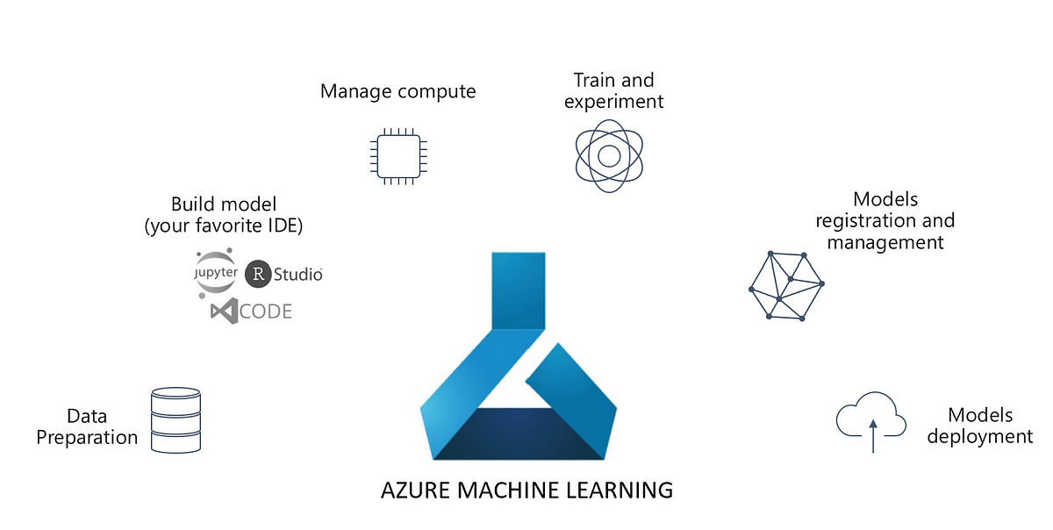
Azure ML Studio and AutoML
Azure ML Studio:
Web-based interface to develop, train, and deploy ML models using drag-and-drop workflows.
Supports both code-first and no-code experiences.
Automated ML (AutoML):
No-code machine learning where Azure automatically selects the best models and hyperparameters.
Ideal for business users or beginners in ML.
Use Case Example:
Rapidly prototype a customer churn prediction model using AutoML.

Slide 32
AI Builder for Power Platform
AI Builder: No-code AI solutions that integrate with Power Apps and Power Automate.
Key Features:
Pre-built models for tasks like form processing, object detection, and text recognition.
Easy deployment in business applications with drag-and-drop simplicity.
Use Case Example:
Automate document approval processes by extracting data from forms.
Build AI-powered mobile apps that recognize products in real-time for inventory management.

Slide 33
Applied AI Services
Form Recognizer: Extracts structured data from invoices, receipts, and business forms.
Azure Cognitive Search: Leverages AI to extract insights from all kinds of content (documents, images).
Azure Bot Service: Build intelligent chatbots that integrate with multiple communication channels.
Use Case Example:
Automate customer service with bots that answer common inquiries.
Streamline document processing workflows by extracting and indexing key data from forms.

Slide 34
Security and Compliance in AI
Built-in security with Azure Active Directory (AAD), role-based access control (RBAC), and Key Vault for managing sensitive information.
Compliance with industry standards such as GDPR, HIPAA, and SOC 2.
Privacy and Responsible AI:
Azure’s commitment to ethical AI development, ensuring transparency, fairness, and accountability in AI models.
Example:
Use Azure AI services to handle sensitive customer data in compliance with healthcare or financial regulations.

Slide 35
CHAPTER 7 Big Data, Reporting, and Analytics Services in Azure
|LEARNING MICROSOFT AZURE

Slide 36
Big Data
Overview of Big Data:
The exponential growth of data in recent years
Shift from traditional analytics to cloud-based solutions
“Data is the new oil” – emphasizing its value in business strategy
Objective:
Understand the impact of big data analytics in driving informed business decisions.
What is Big Data?
Definition and Characteristics:
Volume: Scale of data (terabytes to petabytes)
Variety: Diverse data types (structured, semi-structured, unstructured)
Velocity: Speed of data processing (real-time analytics)
Veracity: Trustworthiness and quality of data
Examples of Big Data Use Cases:
Social media sentiment analysis
IoT sensor data for predictive maintenance
Gaming analytics for user engagement

Slide 37
Big Data
The Need for Big Data Analytics:
Impact of Data on Decision Making:
Evidence-Based Decisions: How analytics help mitigate risks and uncover opportunities.
Data-Driven Strategies: Creating competitive advantages through insights.
Big Data Solutions in Azure
Cloud Services for Big Data:
Azure Synapse Analytics: Integrating big data and data warehousing.
Azure Databricks: Collaborative Apache Spark-based analytics service.
Managed Services:
How Azure simplifies deployment, scaling, and maintenance of big data solutions.
Real-Time Analytics:
Capabilities for processing data streams in real time.

Slide 38
Azure Data & Analytics Services
Azure Database Options
Databases Available in Azure:
Azure SQL Database: Fully managed relational database with scalability.
Azure Cosmos DB: Multi-model database for global distribution and horizontal scalability.
PostgreSQL/MySQL: Open-source databases available as managed services.
Key Features:
Elasticity: Scale up/down as needed.
High Availability: Built-in disaster recovery and backup solutions.
Security: Advanced threat protection and encryption.
Azure Analytics Services
Analytics Products:
Azure HDInsight: Cloud-based service for big data analytics using Hadoop and Spark.
Azure Analysis Services: Provides enterprise-grade analytical data models.
Capabilities:
Generate dashboards and reports with real-time data insights.
Integration with Power BI for advanced visualization.
Data Engineering in Azure
Key Services:
Azure Data Factory: Data integration service for creating ETL and ELT workflows.
Azure Data Lake Storage: Scalable data repository for big data analytics.
Functionality:
Building complex data pipelines to ingest, prepare, and transform data from various sources.
Support for both batch and streaming data.

Slide 39
Machine Learning in Azure
Azure Machine Learning Services (AMLS):
Comprehensive platform for building, training, and deploying machine learning models.
Zero-Code and Code-First Options:
Automated ML: For users with minimal coding experience.
Notebook Experience: For data scientists who prefer coding with Python or R.
Integration with Other Azure Services:
Leveraging data from Azure Synapse and Data Lake for ML model training.

Slide 40
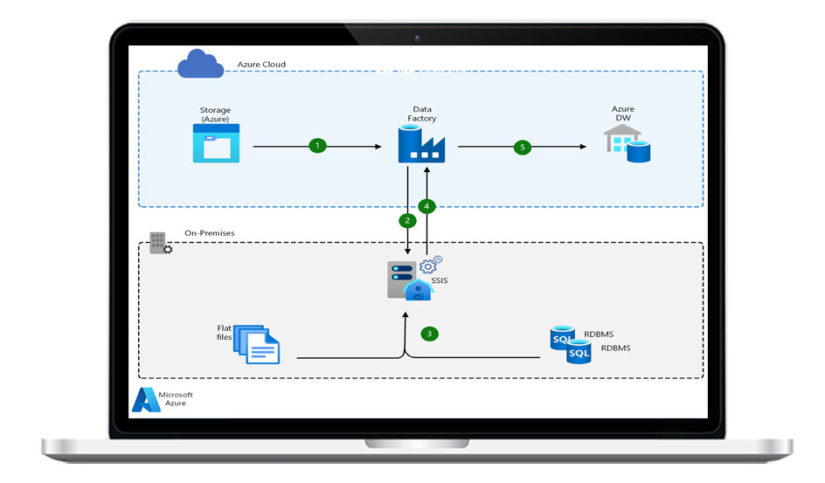
Complex Data Pipeline Tools
Azure Data Factory:
Extract, Load, Transform (ELT): Capabilities for data movement and transformation.
Automation and Scheduling: Set triggers to run workflows on demand or at scheduled intervals.
Real-World Example:
Use case of a retail company analyzing sales data from multiple sources for inventory management.

Slide 41
Designing Big Data Solutions
Four-Step Process:
Evaluation: Assessing business requirements and data sources.
Architecture: Designing a scalable and flexible architecture.
Configuration: Setting up Azure resources to meet the design.
Production: Deploying and monitoring the solution.
Importance of Understanding Data Needs:
Aligning technology with business objectives to drive value.

Slide 42
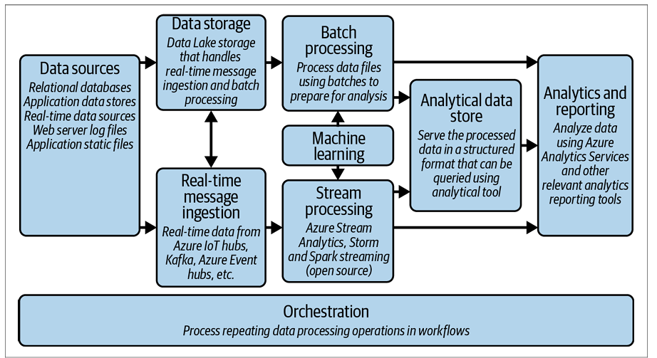
Identifying Big Data Architecture
Categories of Architecture:
Data Volume: Strategies for managing large datasets.
Velocity: Approaches for real-time processing and analytics.
Variety: Handling different data formats and sources.
Sources: Integrating data from IoT, social media, transactional databases, etc.
Implications for System Design:
Balancing performance, cost, and scalability.

Slide 43
Challenges and Considerations
Common Challenges in Big Data:
Data Management: Strategies for cleaning and organizing data.
Integration: Connecting disparate data sources and systems.
Security: Protecting sensitive data and ensuring compliance.
Considerations for Implementation:
Choosing the right Azure services based on specific needs and constraints.

Slide 44
Big Data Architecture in Azure
Introduction: Azure provides a comprehensive architecture for handling large volumes of data from diverse sources, enabling businesses to derive insights and make informed decisions.
Key Components:
Data Sources: Various sources including IoT devices, social media, and enterprise applications.
Data Storage: Scalable storage solutions like Azure Data Lake for unstructured data.
Real-time Ingestion: Tools for real-time data collection from multiple streams.
Batch Processing: Frameworks like Hadoop for processing large datasets.
Stream Processing: Azure Stream Analytics for real-time analytics.
Machine Learning: Integrating ML models to enhance data insights.
Reporting: Visualization tools like Power BI for reporting and dashboards.

Slide 45
Benefits of Azure Big Data Services
Managed Services: Azure provides several managed services that minimize infrastructure management overhead, allowing teams to focus on data and analytics.
Azure Data Lake Store: Scalable and secure data storage.
Azure Synapse Analytics: Integrated analytics service.
Azure Stream Analytics: Real-time data processing service.
Azure Data Factory: Data integration service for ETL processes.
Azure Event Hub: Big data streaming platform.
Azure IoT Hub: Solution for connecting IoT devices.
Open Source Technologies: Azure supports numerous open-source frameworks, allowing developers to leverage existing skills and technologies.

Slide 46
Azure Data Lake
Description: Azure Data Lake is a highly scalable and secure cloud storage solution designed to store massive amounts of unstructured data.
Key Features:
Enterprise-grade security: Ensures data privacy with encryption, authentication, and role-based access control.
Native format data storage: Supports various data formats (JSON, CSV, Parquet, etc.) without requiring pre-processing.
Integration with Hadoop and Spark: Seamlessly works with big data frameworks for analytics and processing.

Slide 47
NoSQL Databases in Azure
Overview: NoSQL databases are designed to handle large volumes of unstructured or semi-structured data, providing flexibility and scalability.
Supported Databases:
Azure Cosmos DB: Globally distributed, multi-model database service for high availability and low latency.
HBase on HDInsight: Open-source NoSQL database that runs on Hadoop for storing and processing big data.
Azure Data Explorer: Fast and highly scalable data exploration service for analyzing large amounts of structured and semi-structured data.

Slide 48
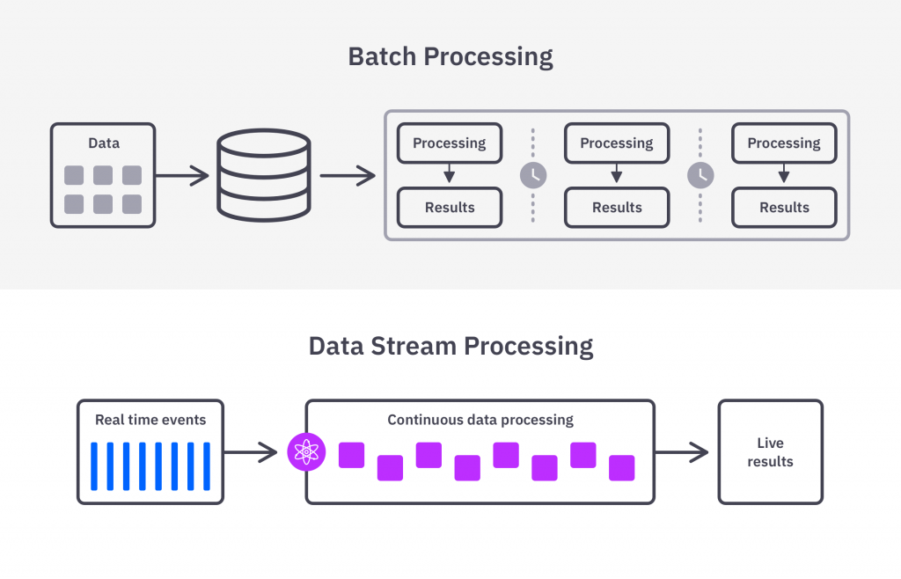
Real-time Stream Processing with Azure Stream Analytics
Functionality: Azure Stream Analytics enables the analysis of real-time data streams from various sources, allowing for timely decision-making.
Key Use Cases:
IoT Monitoring: Real-time analytics for connected devices to monitor performance and detect anomalies.
Web Logs: Analyze web traffic and user behavior for immediate insights.
Point of Sale (POS) Systems: Real-time transaction monitoring for fraud detection and inventory management.
Machine Learning Integration: Enhances analytics capabilities by applying machine learning models to streaming data.

Slide 49
Unified Analytics with Azure Synapse
Description: Azure Synapse is an integrated analytics service that combines big data and data warehousing into a unified experience.
Features:
SQL and Spark integration: Allows users to run queries using either T-SQL or Spark for data processing.
T-SQL queries for data visualization: Facilitates easy querying of data for reporting and visualization.
Serverless and dedicated options: Flexibility to choose between serverless on-demand and provisioned resources.

Slide 50
Collaborative Analytics with Azure Databricks
Overview: Azure Databricks is a collaborative Apache Spark-based analytics platform designed for data science and data engineering.
Key Benefits:
Collaborative workspace: Provides an interactive environment for data scientists and engineers to work together.
Managed Spark clusters: Automatic management of Spark clusters for efficient resource allocation.
Support for multiple languages: Supports Python, R, Scala, and SQL for diverse data processing tasks.

Slide 51
Managed Analytics with Azure HDInsight
Description: Azure HDInsight is a fully managed service for running open-source frameworks such as Apache Hadoop and Spark in the cloud.
Capabilities:
Create and scale data clusters: Easily deploy and manage clusters for big data processing.
Integration with Azure services: Seamless integration with Azure Data Lake Storage and Azure Data Factory for data ingestion and storage.
Support for various frameworks: Includes support for frameworks like Spark, Hive, and Kafka for diverse big data processing needs.

Slide 52
Data Integration with Azure Data Factory
Functionality: Azure Data Factory is a cloud-based data integration service that allows users to create, schedule, and manage data workflows.
Integration Capabilities:
ETL processes: Extract, Transform, Load data from various sources (SQL Server, NoSQL databases, flat files, etc.).
Support for real-time data streaming: Ability to ingest and process data in real-time.
Data orchestration: Automate workflows and monitor data pipelines effectively.

Slide 53
Azure Analysis Services : Enterprise-Grade Data Modeling
Overview: Azure Analysis Services is a cloud-based analytics engine designed for enterprise-grade business intelligence solutions.
Key Features:
High-performance BI solutions: Enables organizations to create complex data models for analytics.
Autoscaling capabilities: Automatically adjusts resources based on workload, optimizing costs and performance.
Integration with Power BI: Seamless integration for creating rich visualizations and reports.

Slide 54
Enhancing Applications with Power BI
Overview: Power BI enables organizations to visualize data and share insights across the organization and embed them in applications.
Embedding Options:
HTML iframe: Easily embed interactive Power BI reports in web applications.
REST APIs and SDKs: Provides extensive APIs for embedding capabilities across various platforms.
Custom Visuals: Support for custom visuals to tailor reports to specific business needs.

Slide 55
Real-World Use Cases of Azure Big Data Services
Retail Analytics: Analyze customer behavior and inventory levels to optimize stock and enhance customer experience.
IoT Solutions: Monitor and analyze data from IoT devices for predictive maintenance and operational efficiency.
Healthcare: Use big data analytics for patient monitoring and improving treatment outcomes.
Financial Services: Fraud detection and risk assessment through real-time analytics of transaction data.

